Slide 1

HDFC Additional SSL 23’

Slide 2
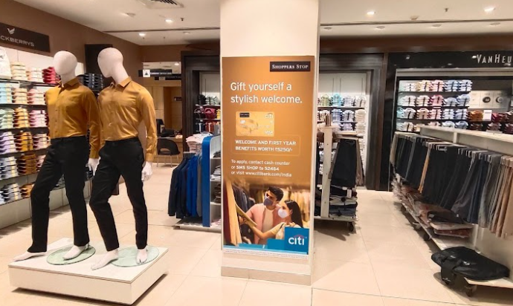

Coimbatore | 59L3V1 | 32” | 72” | Grey Back Self adhesive vinyl with matt lamination

Slide 3
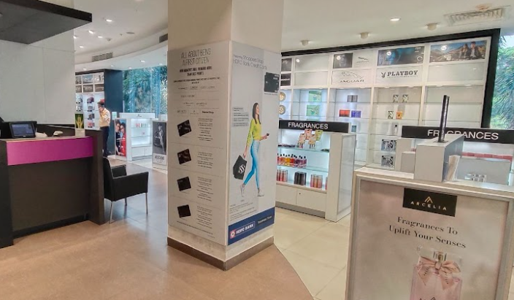
Coimbatore | 59L1V9 | 32” | 72” | Grey Back Self adhesive vinyl with matt lamination

Slide 4
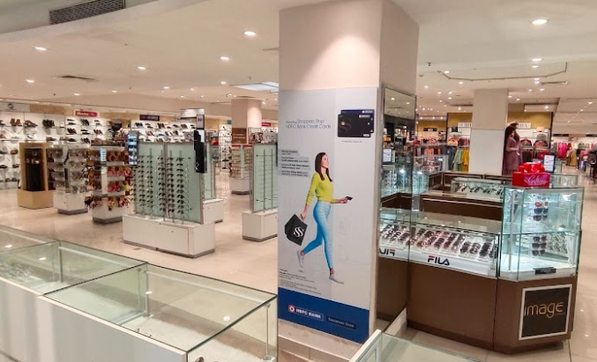
Coimbatore | 59L1V11 | 32” | 72” | Grey Back Self adhesive vinyl with matt lamination

Slide 5
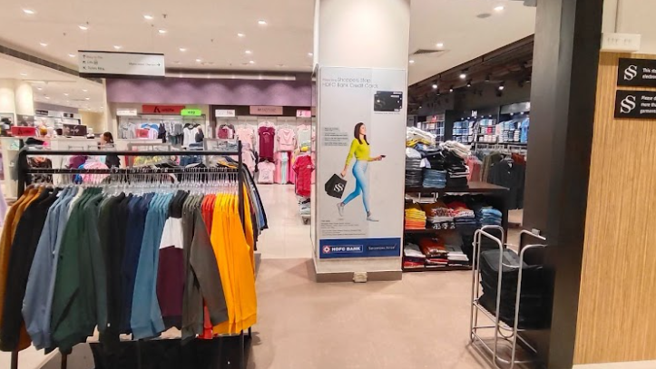
Coimbatore | 59L2V3 | 32” | 72” | Grey Back Self adhesive vinyl with matt lamination

Slide 6
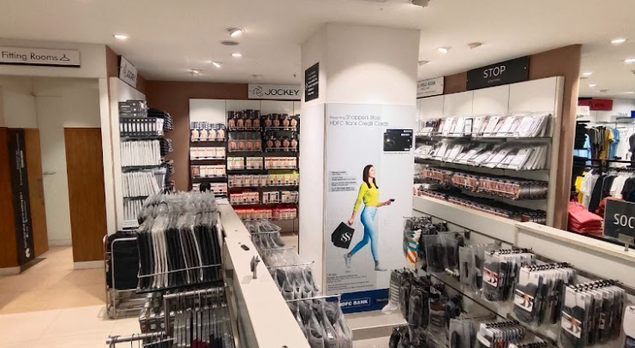
Coimbatore | 59L3V7 | 32” | 72” | Grey Back Self adhesive vinyl with matt lamination

Slide 7
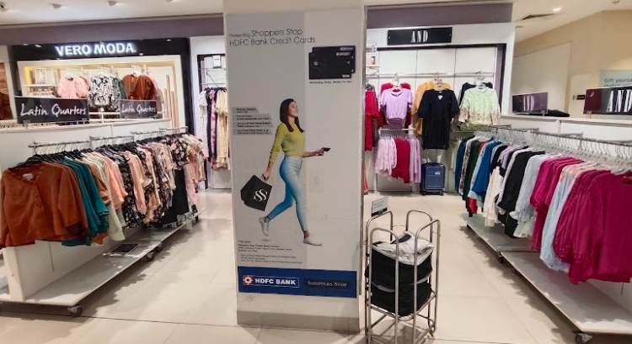
Coimbatore | 59L2V8 | 32” | 72” | Grey Back Self adhesive vinyl with matt lamination

Slide 8
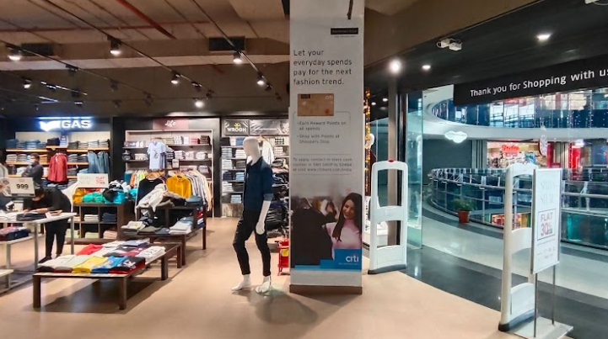

Coimbatore | 59L2V11 | 33” | 124” | Grey Back Self adhesive vinyl with matt lamination

